Slide 1
WASTE MANAGEMENT SYSTEM
LBS INSTITUTE OF TECHNOLOGY FOR WOMEN , POOJAPPURA Submitted By:Fathima Hussain
Sandra B M
Praveena G S
Adithya L
Jyothika K J
Safa N

Slide 2
CONTENTS
THEME
PROBLEM STATEMENT
OBJECTIVE
WORKFLOW
METHODOLOGY
FUTURE WORK
CONCLUSION

Slide 3
THEME
The theme of the project is to help the government to digitize the existing waste management system.

Slide 4
PROBLEM STATEMENT
The existing system does not provide online waste management system .

Slide 5
OBJECTIVE
To develop an online platform for waste management on daily ,weekly or monthly basis which also helps the waste collectors to earn a profit by selling it to recycling units.

Slide 6
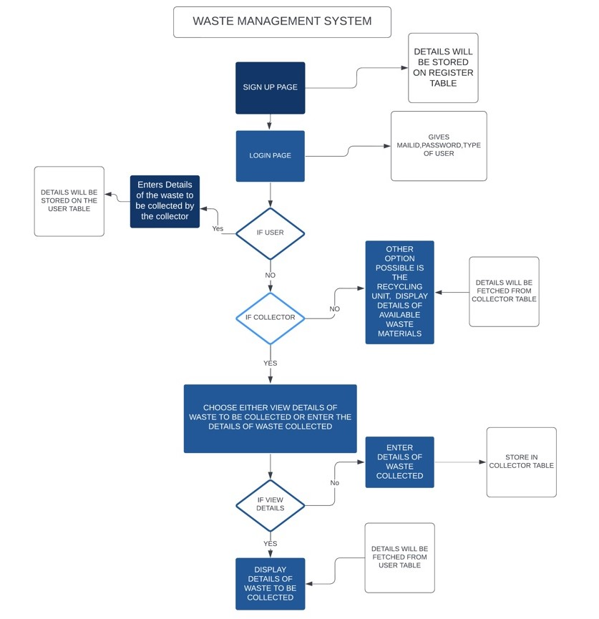
WORKFLOW

Slide 7
METHODOLOGY
The proposed Waste management system can be broadly categorized into 3 modules:
User
The user can login/sign up and enter the details of the wastes to be collected.
Collector
The collector can login/sign up and enter the waste collected by the collector and its rewards per weight or can view the requests from users for collecting wastes.
Recycling units
The recycling units can login/sign up and will be displayed of the details of waste materials that he can buy from collector.
The Software Requirements are:
Frontend-HTML,CSS
Backend-PHP,MYSQL
PHP tools-xampp-win32-7.3.2-0-VC15

Slide 8
FUTURE WORK
GPS integrated system for location tracking.
A system for updating and recording rewards from user to collector.
A system to provide status of the collector.

Slide 9
CONCLUSION
Improper disposal of wastes can create a havoc for both human beings and animals. Waste management system is an important system which is user-friendly and easy-to-use and helps the recycling units,collectors & users gain profits which encourages them to run it smoothly which in turn provides us with an eco-friendly,low wastage system.

Slide 10
CONTRIBUTIONS
JYOTHIKA K J : Creation of back end connecting codes for collecting and storing data from webpage into the database and for displaying data from database to the webpage. Creation of database and data flow diagram. Configured the Git repository for placing the code.Coordinated with the team members for the overall integration of the project.
SAFA N : Creation of user page,redirection page of collector and linking them with view details page and collector details page,creation of presentation slides and acted as an overall team player in project ideas and for its successful implementation.
SANDRA B M : Creation of Login page and Sign Up page. Helped with the documentation of the project and coordinated with the team members for the overall integration of the project.
FATHIMA HUSSAIN :Collector page creation.Github documentation.Helped with ppt contents.Overall co-ordination between the team members .
ADITHYA L : Login page creation and linking of webpages in the login page to the user , collector and recycling units . Linking of sign up page with login page.Overall co-ordination between the team members . Helped in the documentation of the project .
PRAVEENA G S : Login page creation and linking of webpages in the login page to the user , collector and recycling units . Linking of sign up page with login page.Overall team co-ordination . Plays a role in the documentation of the project .

